Slide 1
Superstore Sales Analysis & Data Storytelling
Data Analytics Internship Project
Name: Sumit Sharma
Tools Used: Python, SQL, Power BI

Slide 2
Project Objective
The objective of this project is to analyze sales data from the Superstore dataset to identify key business insights.
The analysis focuses on:
• Sales performance
• Regional trends
• Product category performance
• Customer segments

Slide 3
Dataset Overview
Dataset Name: Superstore Sales Dataset
Total Records: 9800
Total Columns: 21
Key Fields:
• Order Date
• Category
• Region
• Segment
• Sales
• Shipping Days

Slide 4
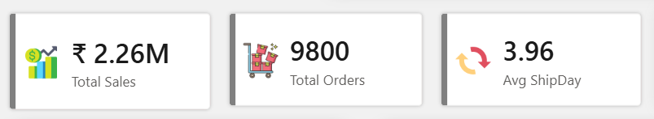
Key Performance Indicators
Total Sales: ₹2.26M
Total Orders: 9800
Average Shipping Days: 3.95

Slide 5
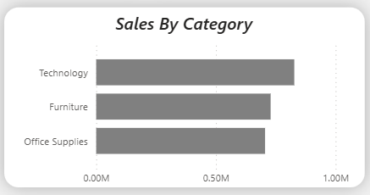
Sales Performance by Category
Technology category generates the highest sales revenue.
Furniture and Office Supplies contribute moderate sales.

Slide 6
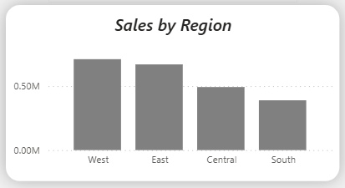
Regional Sales Analysis
The West region contributes the highest overall sales.
The South region has the lowest sales performance.

Slide 7
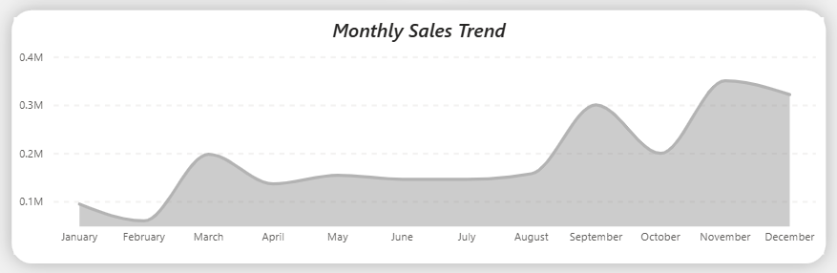
Monthly Sales Trend
Sales increase toward the end of the year.
This indicates seasonal demand during the final months.

Slide 8

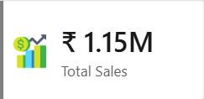

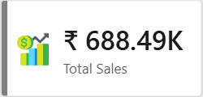

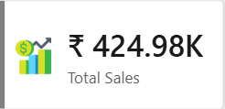
Customer Segment Performance
Consumer segment generates the highest number of orders.
Corporate and Home Office segments contribute smaller portions.

Slide 9
Hypothesis Testing
Hypothesis:
Technology category generates significantly higher sales than other categories.
Null Hypothesis (H0):
Technology sales are equal to other categories.
Alternative Hypothesis (H1):
Technology sales are higher than other categories.

Slide 10
Statistical Validation
A T-Test was performed to compare sales of Technology category with other categories.
Result:
p-value < 0.05
Conclusion:
Technology category sales are statistically higher than other categories.

Slide 11
Key Business Insights
• Technology category drives the highest revenue.
• West region performs best in sales.
• Sales increase toward the end of the year.
• Consumer segment contributes the most orders.

Slide 12
Conclusion
The analysis shows that technology products and the West region drive most of the revenue.
Recommendations:
• Focus marketing on high-performing regions.
• Increase inventory for high-demand products.
• Prepare for seasonal demand increases.

